Slide 1
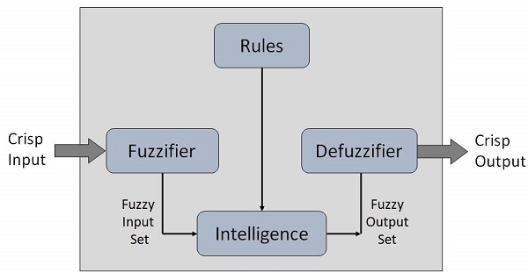
Tutorial 11
﻿CS5486 Intelligent Systems:
Fuzzy Logic and Fuzzy Systems
Hongzong Li
Department of Computer Science City University of Hong Kong

Slide 2
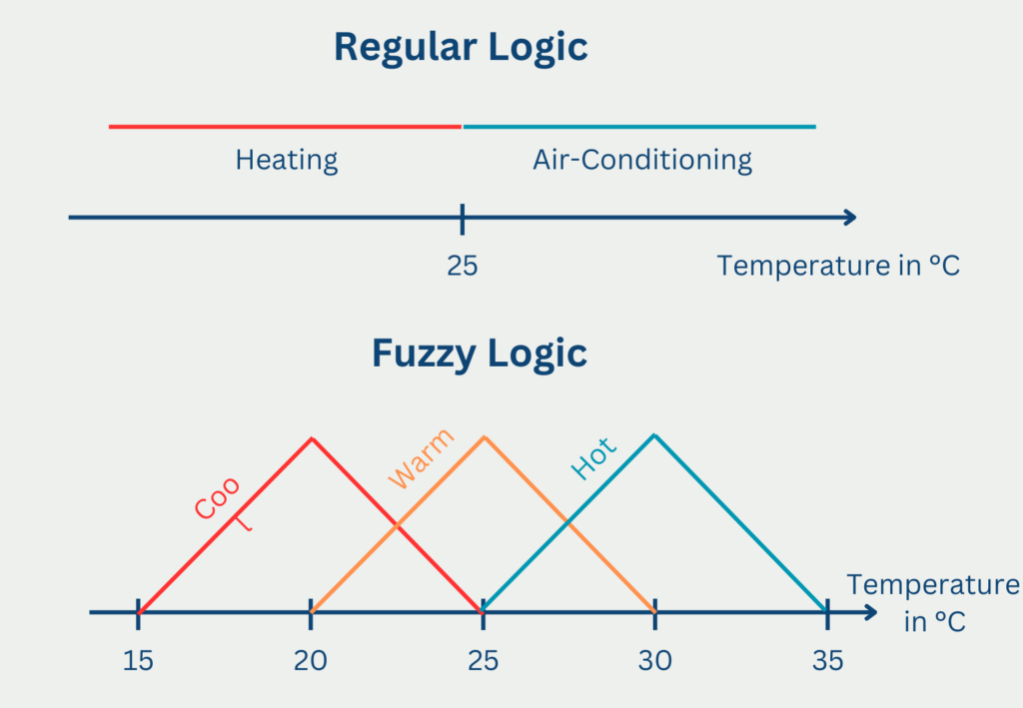
﻿Fuzzy Logic
What is Fuzzy Logic?
Fuzzy Logic is a form of many-valued logic that deals with approximate reasoning rather than fixed and exact inference. Unlike classical binary logic (where variables are either 0 or 1), fuzzy logic variables can have a value anywhere in the range [0, 1].
Inspired by human reasoning – not everything is black or white.

Slide 3

﻿Fuzzy Logic
Crisp vs. Fuzzy Set
Crisp sets have clearly defined boundaries; an element either belongs to the set or not.
Fuzzy sets allow partial membership, meaning an element can belong to a set to a certain degree between 0 and 1.

Slide 4
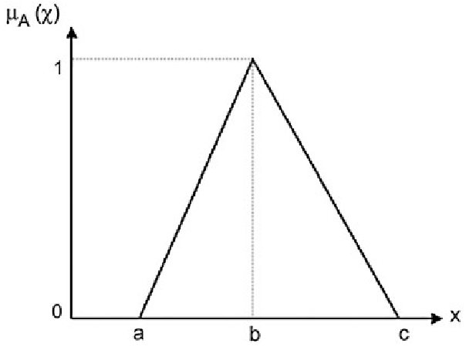
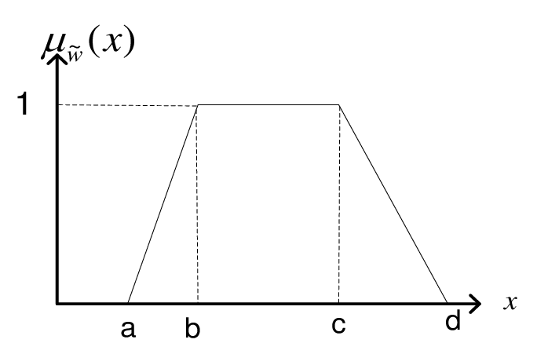
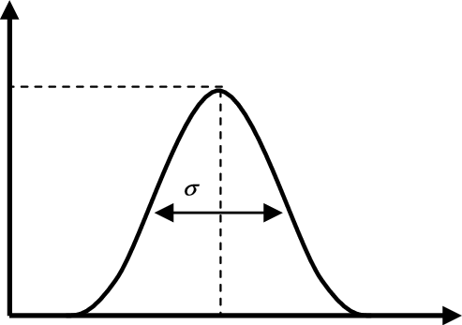
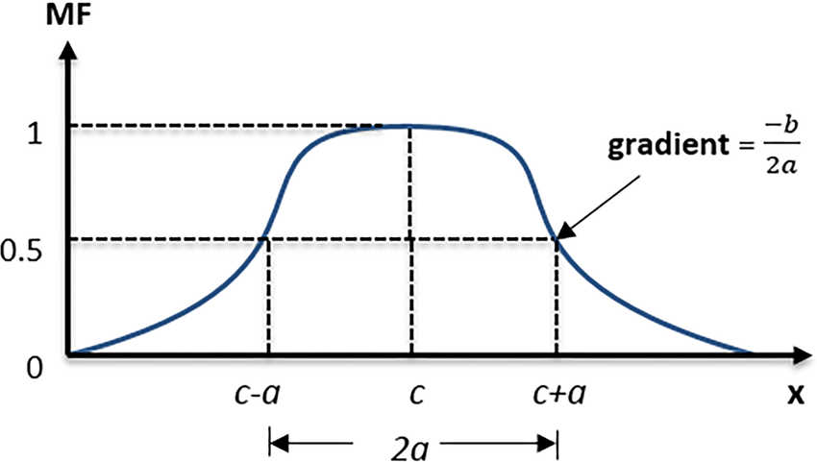
﻿Fuzzy Logic
Membership Functions
Triangular
Trapezoidal
Gaussian
Bell-shaped
Membership functions map elements of a universe of discourse to a membership value between 0 and 1, representing the degree to which an element belongs to a fuzzy set.

Slide 5
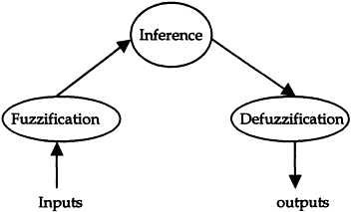
﻿Fuzzification
Fuzzification: Converting crisp input values into fuzzy values using membership functions.

Slide 6
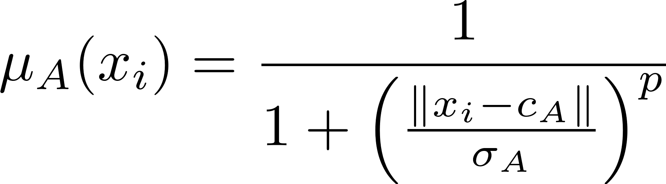


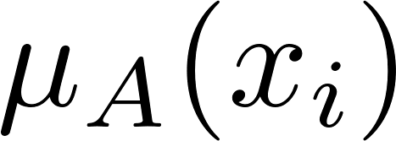
﻿ Fuzzification
Support Fuzzification(s-fuzzification) Method
Step 1: Data Normalization
x_normalized = (x - min(x)) / (max(x) - min(x))
Step 2: Define Support-Based Membership Function
A commonly used support function is:
: center of fuzzy set A
: spread or bandwidth
Step 3: Select Set Centers: Choose centers of fuzzy sets (either:
Manually (e.g., evenly spaced)
Cluster-based (e.g., K-means or FCM cluster centers))
Step 4: Compute Memberships
For each data point x_{i} and each fuzzy set center c_{j}, compute membership using the selected support function.
Notes:
Let’s say we want 3 fuzzy sets (Low, Medium, High), we might set:
centers = [0.2, 0.5, 0.8]

Slide 7
﻿Inference Engine
Inference Engine: Applies fuzzy logic rules to the fuzzified inputs to derive fuzzy outputs.

Slide 8
Defuzzification
Defuzzification: Converts fuzzy output sets into a single crisp value, often using methods like Centroid or Max-membership.

Slide 9
﻿Fuzzy Systems
A Fuzzy System is a rule-based system that uses fuzzy logic to map inputs to outputs. It models human-like reasoning by using imprecise or vague information and producing meaningful outputs based on degrees of truth rather than binary true/false values.
It is commonly used in control systems, decision support, and AI where crisp mathematical models are hard to obtain.
﻿Type-I fuzzy systems
Type-II fuzzy systems

Slide 10
﻿Fuzzy Systems
﻿Type-I fuzzy systems vs. Type-II fuzzy systems
Type-2 fuzzy sets and systems generalize standard Type-1 fuzzy sets and systems so that more uncertainty can be handled.
Type1 fuzzy systems are working with a fixed membership function, while in type-2 fuzzy systems the membership function is fluctuating. A fuzzy set determines how input values are converted into fuzzy variables.

Slide 11
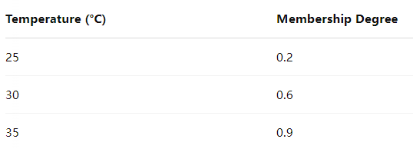
﻿Fuzzy Systems
Type-I Fuzzy Systems
Type-I fuzzy logic uses crisp membership functions (single-valued). Each element has a degree of membership between 0 and 1 in a fuzzy set.
The membership function μ(x) assigns a specific degree of membership to each input.

Slide 12
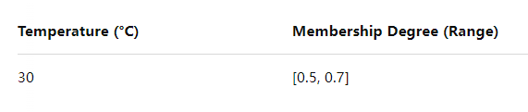
﻿Fuzzy Systems
Type-II Fuzzy Systems
Type-II fuzzy logic systems use fuzzy membership functions. That means, the membership degree itself is a fuzzy set. This allows them to model uncertainty about uncertainty.
This means the degree of membership is not fixed—it’s an interval or even a fuzzy set of values.
Type-II systems are especially useful when expert knowledge, measurements, or linguistic terms are imprecise or vary among different people.
Can model more uncertain environments.
More robust in noisy settings.
Computationally more intensive.
Needs extra steps like type-reduction before defuzzification.

Slide 13
﻿Fuzzy Systems
An Example
Imagine you're building a voice-controlled system that interprets commands based on how users speak — particularly their speaking speed (slow/medium/fast) and volume (low/medium/high).
Challenge
Different users speak at different speeds and volumes.
Microphones vary in quality; background noise is unpredictable.
Type-I Fuzzy: “Fast speech” = 160–200 words per minute, μ = 0.8
Type-I systems cannot capture these kinds of uncertainties. They break down when facing vague, noisy, or subjective input.
Type-I Fuzzy: “Fast speech” = 160–200 wpm, with membership μ ∈ [0.6, 0.9]

Slide 14
﻿Fuzzy Systems
1. Fuzzification
speech_speed = 180 wpm
Instead of mapping it to a crisp μ, you map it to a fuzzy membership interval:
μFast(180) = [0.6, 0.9]
2. Rule Evaluation
Assume a fuzzy rule:
IF speech is Fast THEN increase volume.
A Type-I system: you’d apply the rule with μ = 0.8, and that gets passed through the inference engine.
A Type-II system: You apply the rule using the interval [0.6, 0.9]

Slide 15
﻿Fuzzy Systems
3. Type-Reduction (Type-II systems)
Let’s say after all rule processing, the final output fuzzy set for "volume level” becomes:
volume_output = [5.3, 6.8]
4. Defuzzification
Finally, convert that interval into a crisp output (like 6.05) — usually by averaging the endpoints or applying weighted strategies.
final_output = (5.3 + 6.8) / 2 = 6.05

Slide 16
﻿Fuzzy Systems
Feature | Type-I Fuzzy System | Type-II Fuzzy System
Membership Function | Crisp (single value) | Fuzzy (range or fuzzy set)
Uncertainty Handling | Low to moderate | High
Complexity | Low | High
Use Case | Simple or moderately uncertain systems | Highly uncertain systems (e.g., noisy environments)
Defuzzification | Direct | Requires type-reduction first
Type | Pros | Cons
Type-I | Simple, efficient, widely used | Limited ability to handle complex uncertainty
Type-II | Robust, handles uncertainty in rules & inputs | Computationally expensive, harder to design

Slide 17
What is the difference between crisp sets and fuzzy sets?

Slide 18
Explain the terms: (a) Fuzzification, (b) Inference Engine, and (c) Defuzzification.

Slide 19
Thanks

